Slide 1
Financial Criteria
Chapter 2, T1
M K Hamirwasia
WILPD

Slide 2
AE/DE/MM/ES/POM ZG523-Merged
Project Management
Lecture No. 05

Slide 3
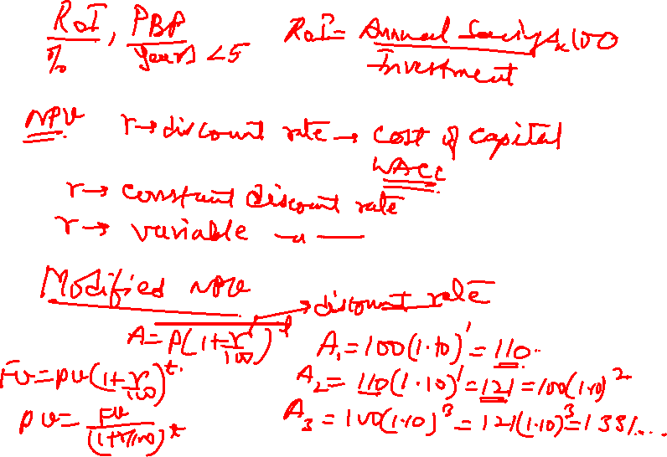

Slide 4
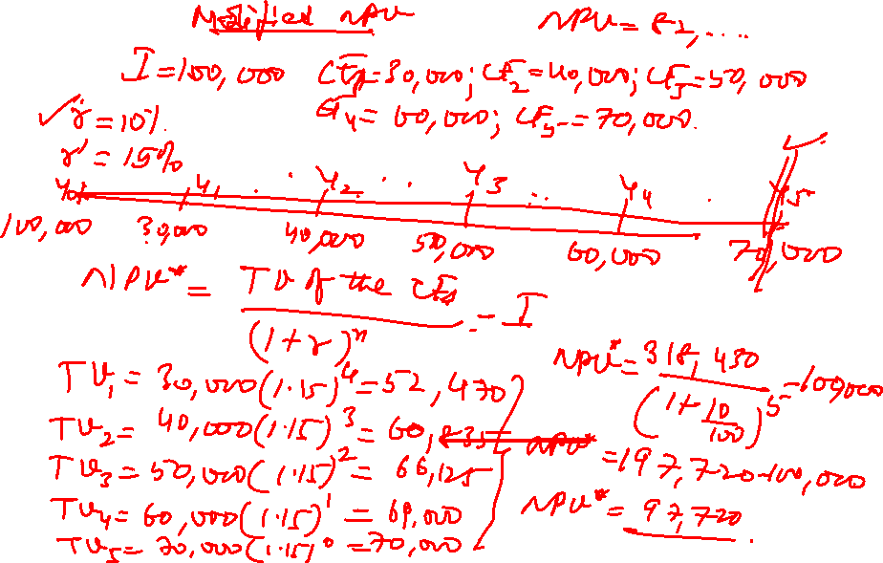

Slide 7
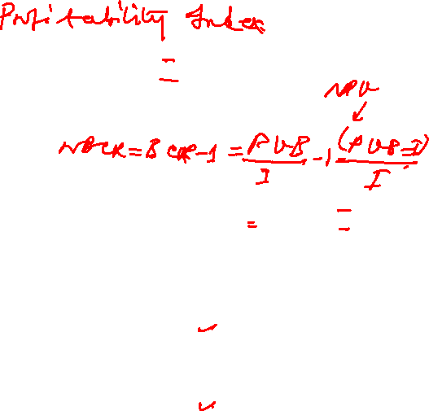
BENEFIT COST RATIO
BENEFIT COST RATIO (BCR) = (PVB) / I
PVB = PRESENT VALUE OF BENEFITS
I = INITIAL INVESTMENT
NET BENEFIT COST RATIO (NBCR) = BCR – 1 (NPV / I)
BCR NBCR RULE
> 1 > 0 ACCEPT
= 1 = 0 INDIFFERENT
< 1 < 0 REJECT

Slide 8
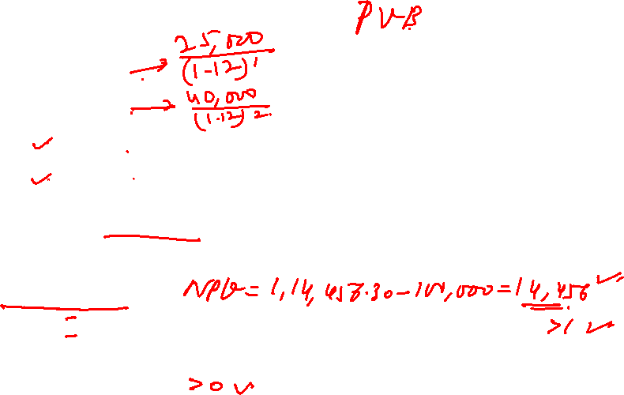
EXAMPLE 2
INITIAL INVESTMENT (I) : 100,000
Year Cashflow
YEAR 1 25,000
YEAR 2 40,000
YEAR 3 40,000 {25000 / (1.12)¹} {40000 / (1.12)³}
YEAR 4 50,000 {40000 / (1.12)²}
BCR = PVB / I r = 12% {50000 / (1.12)⁴}
PVB = 22,321.43+31,887.76+28,471.21+31,775.90
= 1,14,456.30
BCR = PVB / I = 114456.30 / 100000 = 1.14456 = 1.145 NBCR = BCR – 1 = 0.145 {(114456.30–100000)/100000}

Slide 9
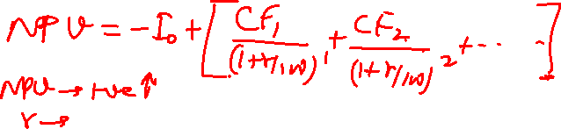
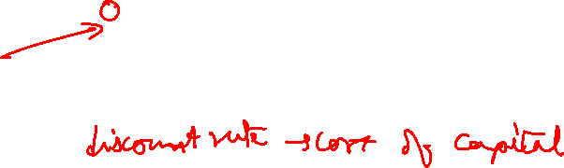
IRR Method
IRR is defined as that value of discount rate, which would make the NPV of the project equal to zero.
If the value of IRR is higher than a certain rate specified by the Organization (often called “hurdle rate”), the project is accepted and if it is lower, the project is rejected.
The hurdle rate is usually based on the WACC.

Slide 10
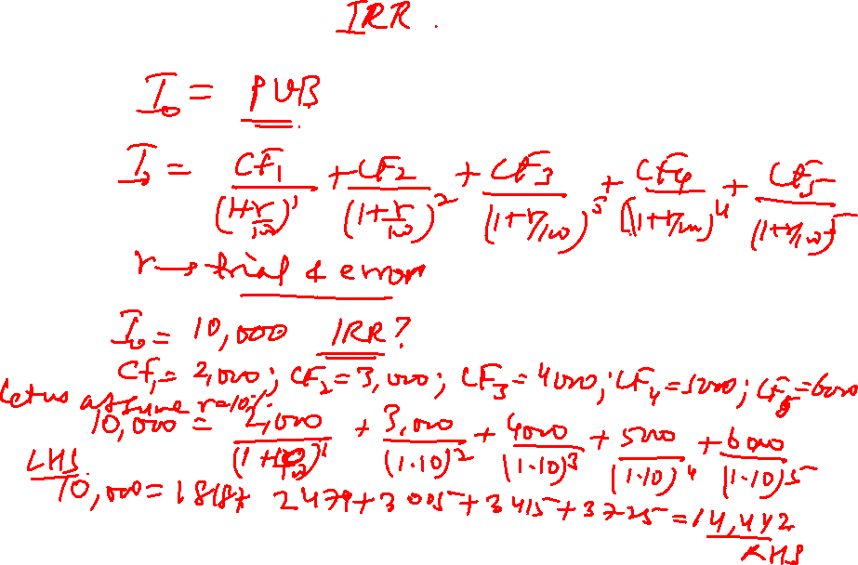

Slide 11
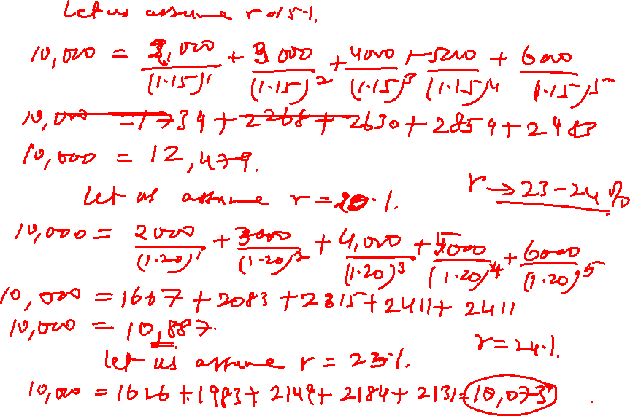

Slide 12
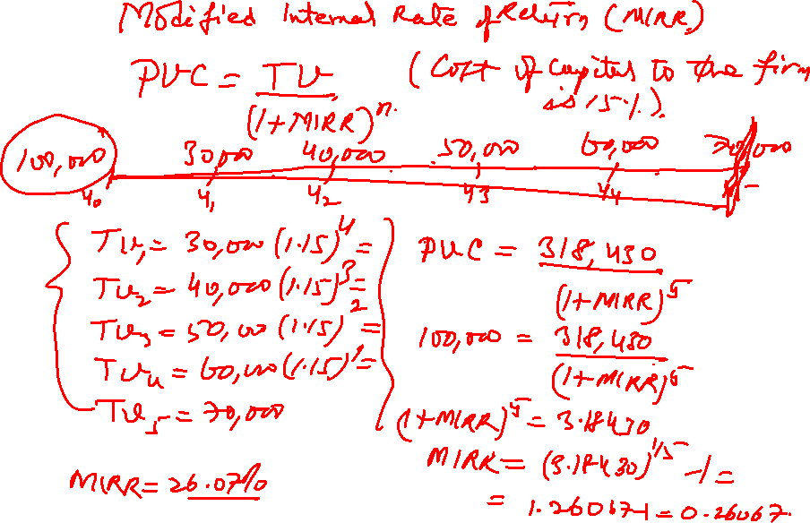

Slide 13
DISCOUNTED PAYBACK PERIOD
It Takes Into Account Time Value Of Money
Cash Flows Are Converted To Their Present Values By Applying Discounting Factors
Find The Cumulative Net Cash Flow After Discounting Till We Get Positive Value
The Corresponding Period Shows The Discounted Payback Period

Slide 14
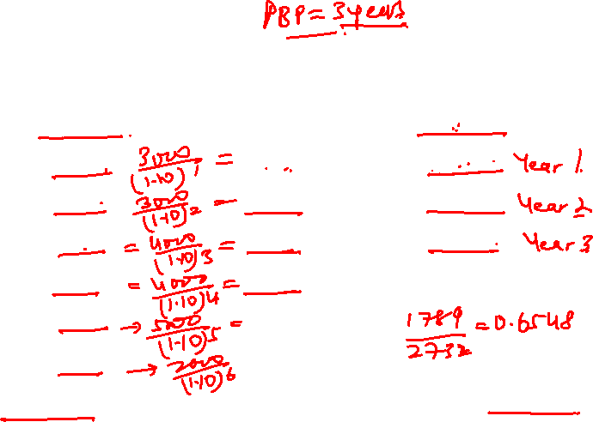
EXAMPLE: DISCOUNTED PAYBACK PERIOD
YEAR CASH FLOW PRESENT VALUE CUM.
0 -10000 -10000 -10000
1 3000 2727 -7273
2 3000 2479 -4794
3 4000 3005 -1789
4 4000 2732 943
5 5000 3105
6 2000 1129
Assuming r = 10% Discounted Payback Period = 3.6548 years (Gives the actual / real picture of recovery)
Undiscounted Payback Period = 3 years

Slide 15
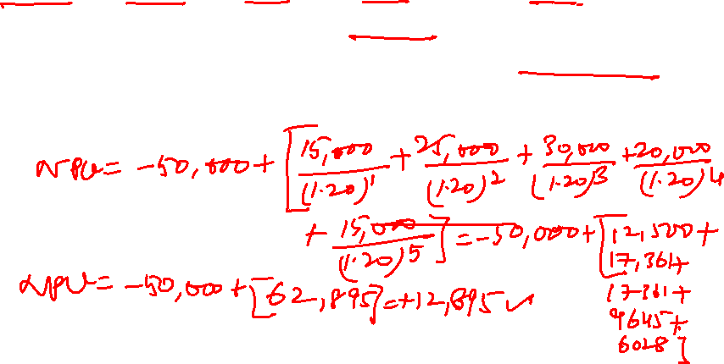
Exercise
1. A five-year project has a projected net cash flow of $15,000, $25,000, $30,000, $20,000, and $15,000 in the next five years. It will cost $50,000 to implement the project. If the required rate of return is 20 percent, conduct a discounted cash flow calculation to determine the NPV.

Slide 17
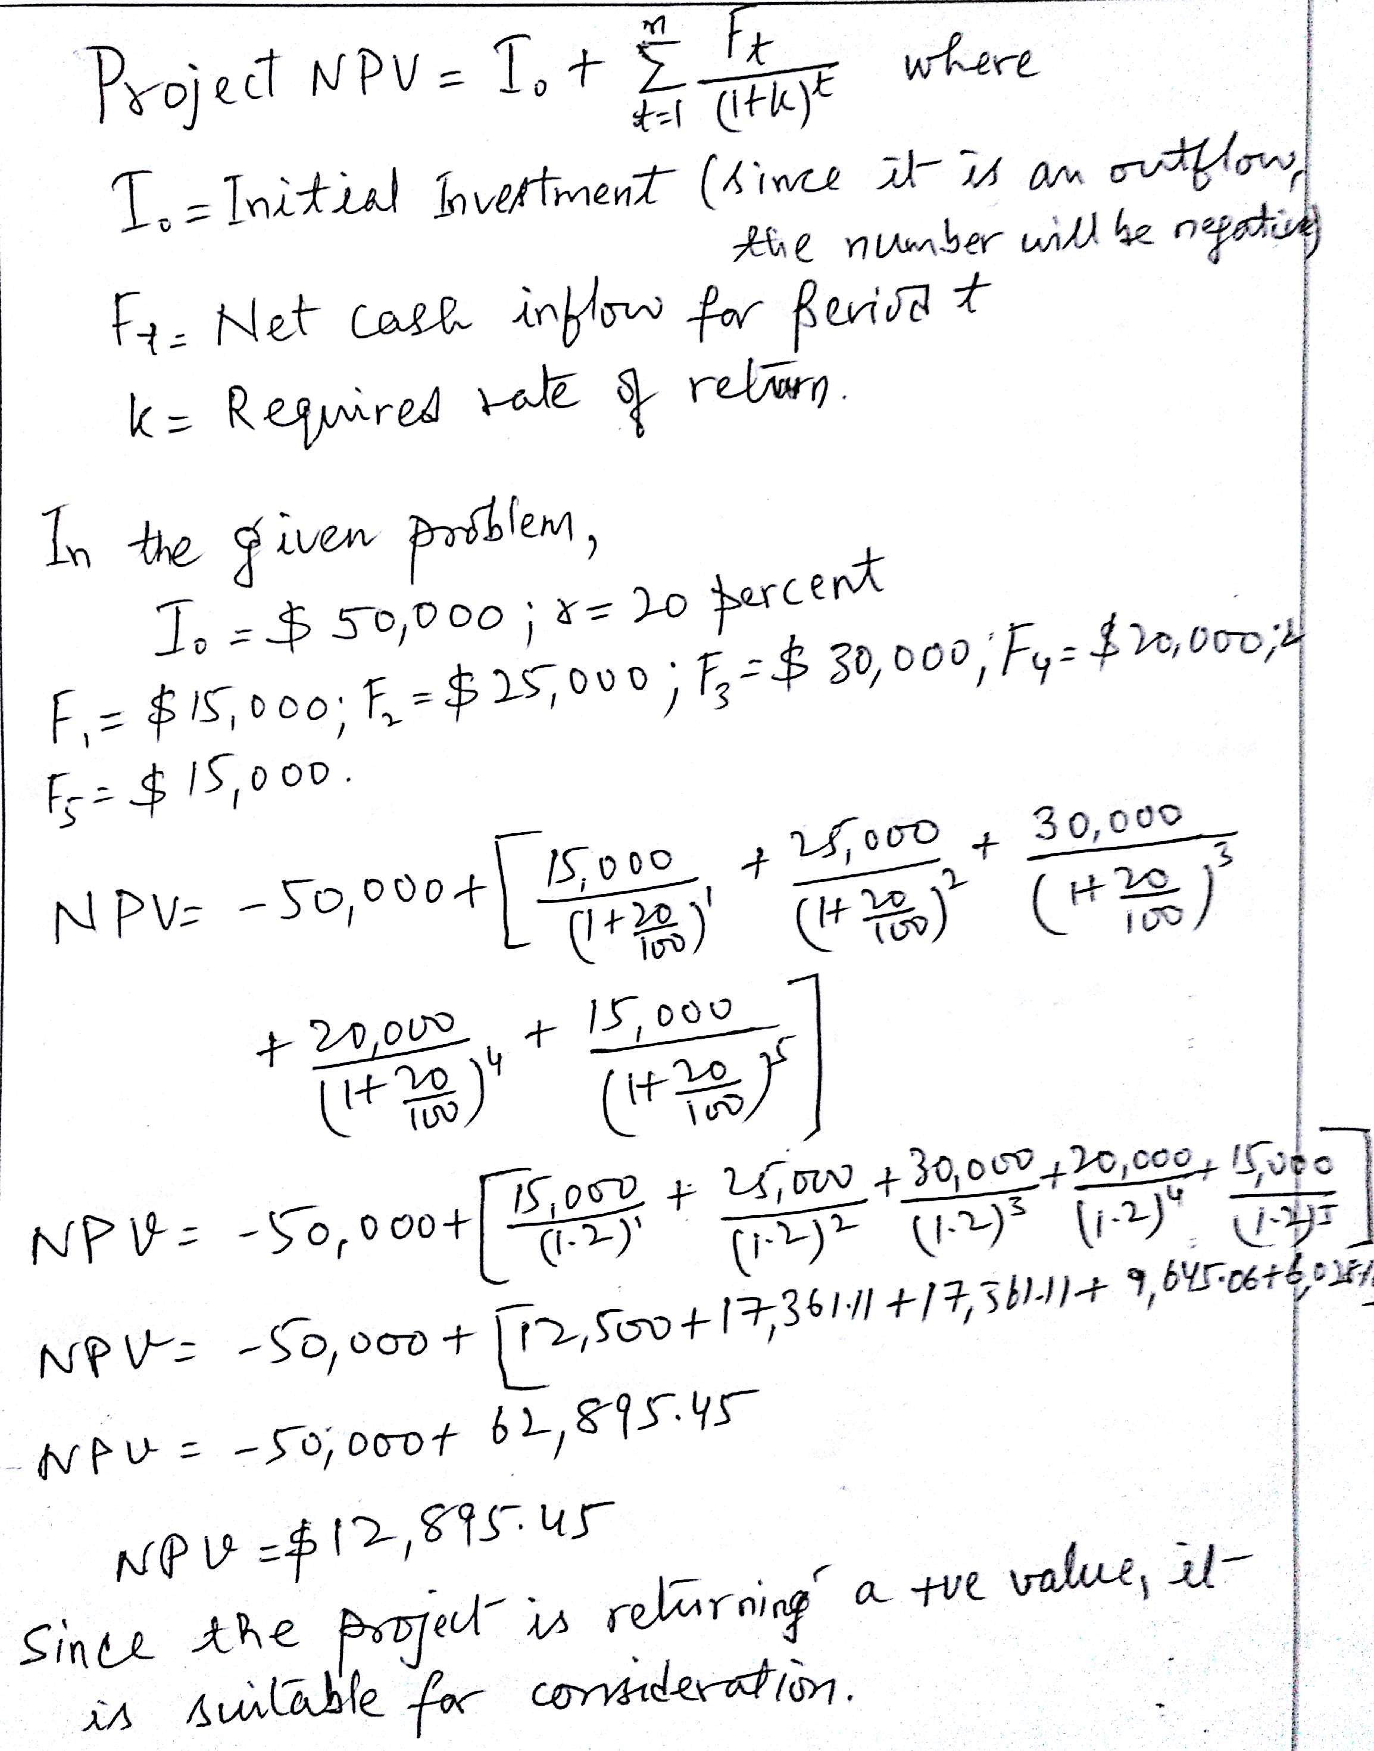
NPV Calculation

Slide 18
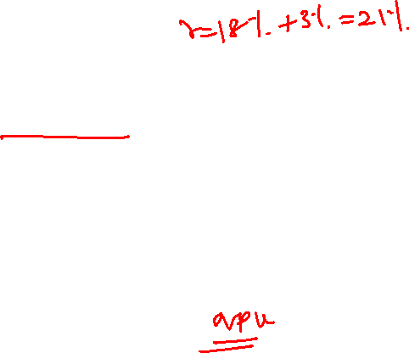
Exercise
2. You work for the 3T Company, which expects to earn at least 18 percent on its investments. You have to choose between two similar projects. Below is the cash information for each project. Your analysts predict that inflation rate will be a stable 3 percent over the next 7 years. Which of the two projects would you fund if the decision is based only on financial information? Why?

Slide 19
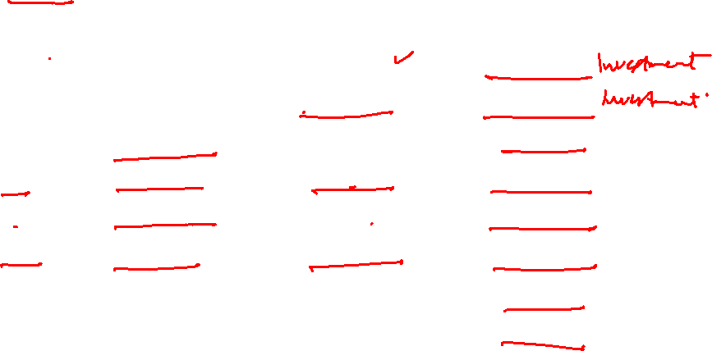
Exercise
Omega
Year Inflow Outflow Netflow
Y0 0 $225,000 -225,000
Y1 0 190,000 -190,000
Y2 150,000 0 150,000
Y3 220,000 30,000 190,000
Y4 215,000 0 215,000
Y5 205,000 30,000 175,000
Y6 197,000 0 197,000
Y7 100,000 30,000 70,000
Total 1,087,000 505,000 582,000

Slide 20
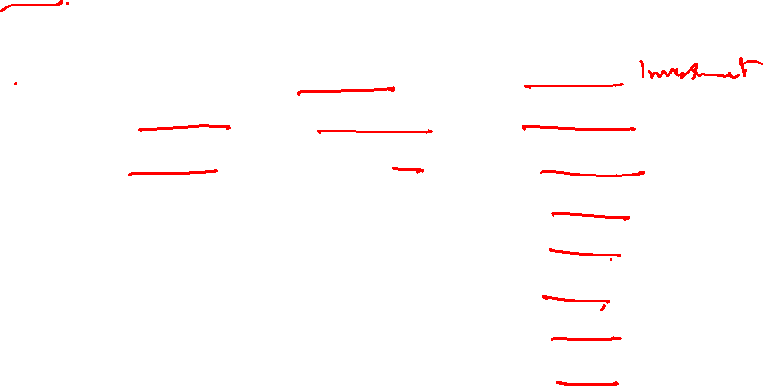
Exercise
Alpha
Year Inflow Outflow Netflow
Y0 0 $300,000 -300,000
Y1 50,000 100,000 -50,000
Y2 150,000 0 150,000
Y3 250,000 50,000 200,000
Y4 250,000 0 250,000
Y5 200,000 50,000 150,000
Y6 180,000 0 180,000
Y7 120,000 30,000 90,000
Total 1,200,000 530,000 670,000

Slide 21
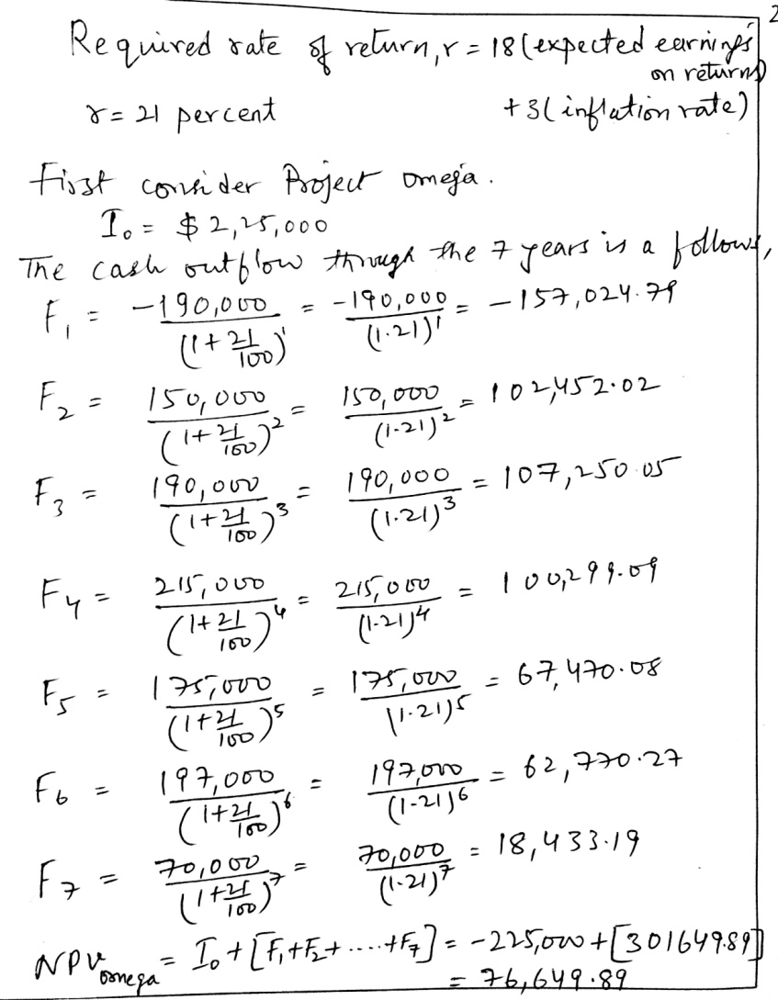
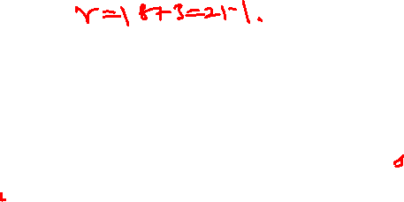
NPV Calculation

Slide 22
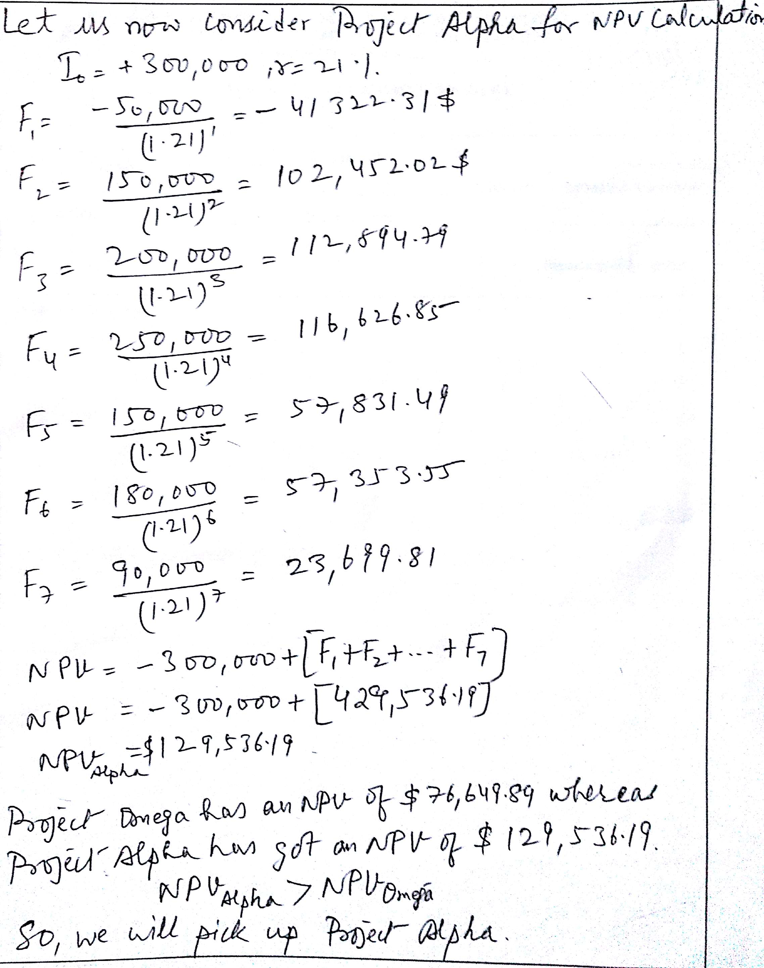

NPV Calculation

Slide 23
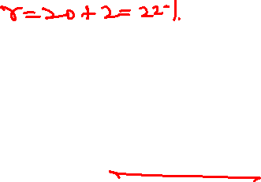
Exercise
3. You are the head of the project selection team at Broken Arrow records. Your team is considering three different recording projects. Based on past history, Broken Arrow expects at least a rate of return of 20 percent. Your financial advisors predict inflation to remain at 2 percent into the foreseeable future.
Given the following information for each project, which one should be Broken Arrow’s first priority? Should Broken Arrow fund any other project(s)? If so, what should be the order of preference based on return on investment?

Slide 24
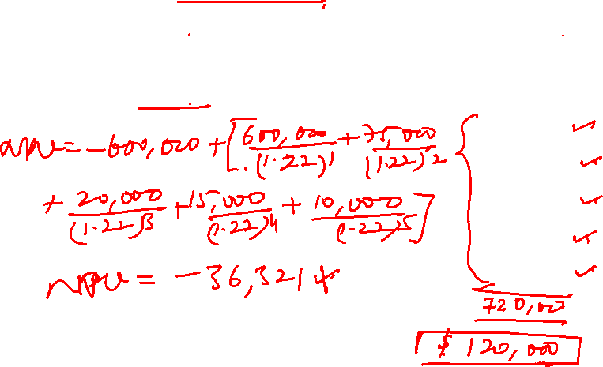
Exercise
Recording Project: Time Fades Away
Year Investment Revenue Stream
0 $600,000 0
600,000
75,000
20,000
15,000
10,000

Slide 25
Exercise
Recording Project: On the Beach
Year Investment Revenue Stream
0 $400,000 0
400,000
100,000
25,000
20,000
10,000

Slide 26
Exercise
Recording Project: Tonight’s the Night
Year Investment Revenue Stream
0 $200,000 0
200,000
125,000
75,000
20,000
10,000

Slide 27
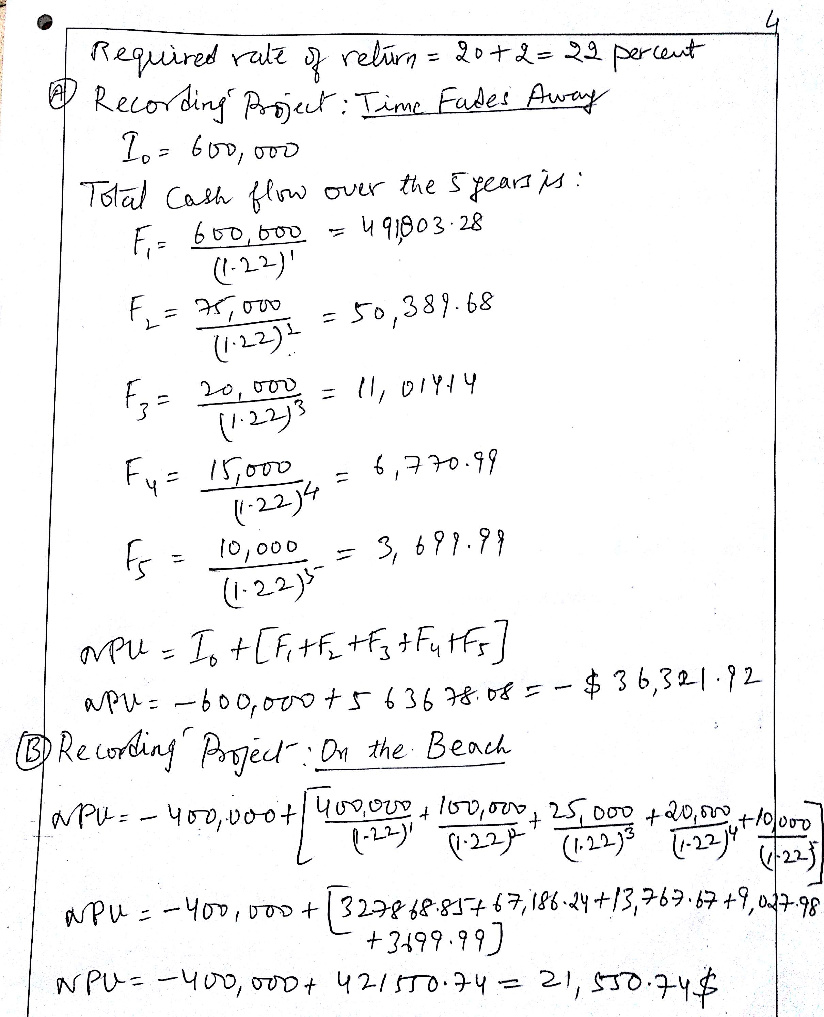
NPV Calculation

Slide 28
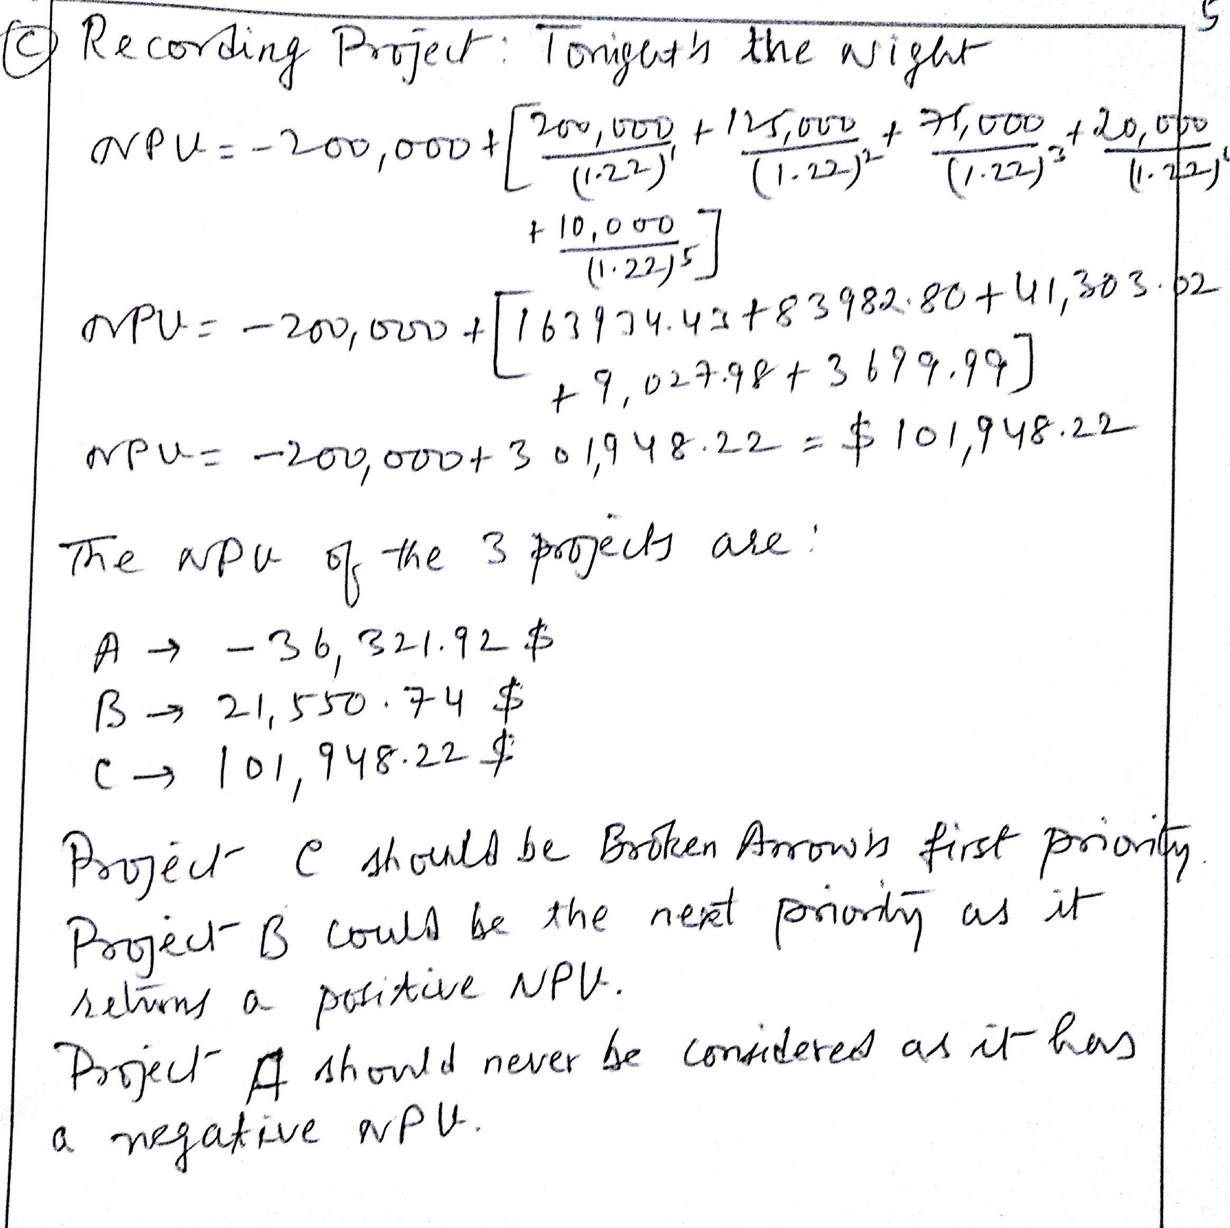
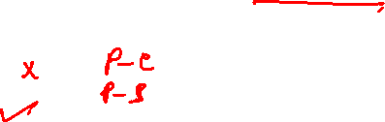
NPV Calculation

Slide 29
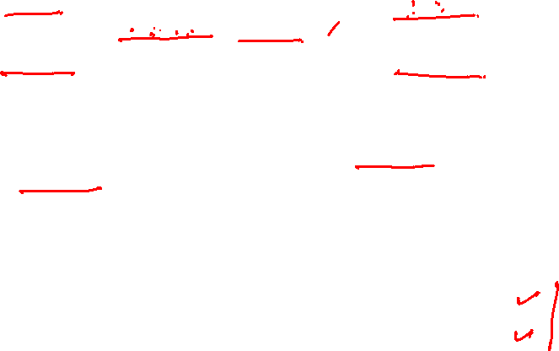
Pay Back Period
Project X has an initial investment of 10,50,000 and projected cash inflows of 2,37,500 for 5 years.
Project Y has an initial investment of 8,00,000 and projected cash inflows of 1,80,000 for 5 years.
Payback period (in years) = Estimated Project Cost/Annual Savings
The payback period for Project X is 4.42105 years and for Project Y is 4.44444 years.
Both the projects are acceptable as they return the initial investment in less than 5 years.
ROI is reciprocal of Payback.
ROI: Project X = (237500/1050000) ×100 = 22.62 %
Project Y = (180000/800000) × 100 = 22.50 %
Management Criteria: Accept, if Payback Period is less than 5 years and ROI is more than 15% (desired rate of return). Project X is slightly more favourable.

Slide 30
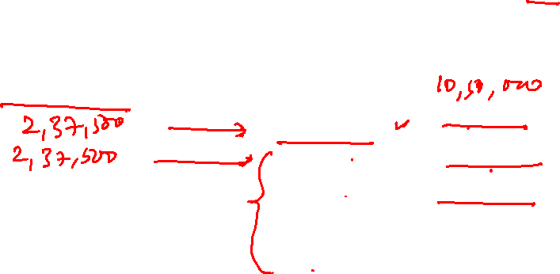
Discounted Pay Back Period
Project X (undiscounted payback period is 4.42 years)
If you were to consider the payback period after considering the discounted values, assuming r to be 15 percent.
Year Outflow Discounted value of cash inflow
0 10,50,000 -----
206521.74
179584.12
156160.11
135791.40
118079.47
Total 796136.84

Slide 31
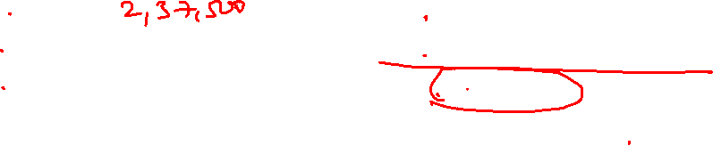
Discounted Pay Back Period Project X
Year Outflow Discounted value of cash inflow
0 10,50,000 -----
206521.74
179584.12
156160.11
135791.40
118079.47
102677.80
89285.05
77639.17
Total 1065738.86 (7.797282 years)

Slide 32
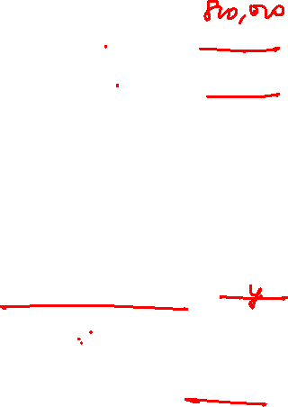
Discounted Pay Back Period Project Y (undiscounted payback period is 4.44 years)
Year Outflow Discounted value of cash inflow
0 8,00,000 -----
156521.74
136105.86
118352.92
102915.58
89491.81
77818.96
67668.67
58842.32
Total 807717.87 (7.8688 years)

Slide 33
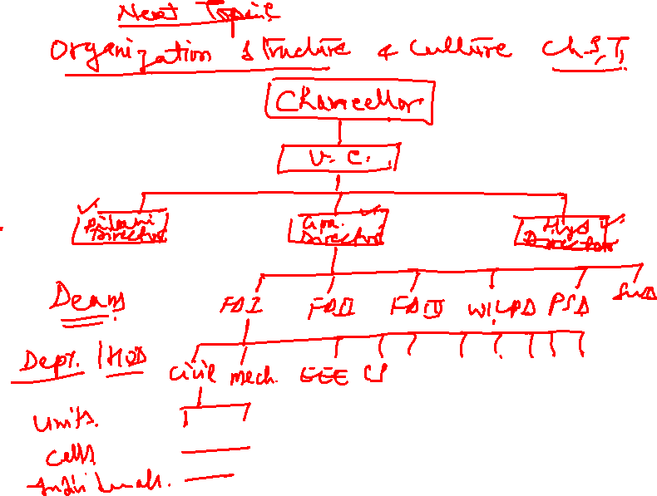

Slide 34
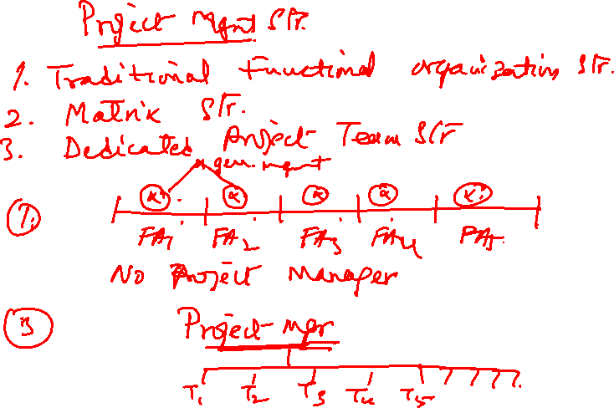

Slide 35
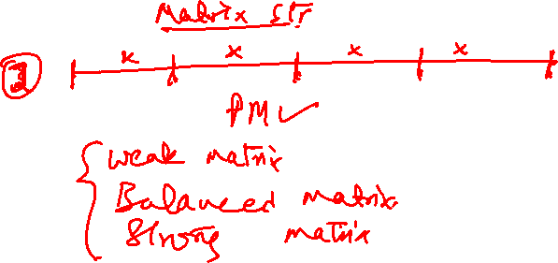
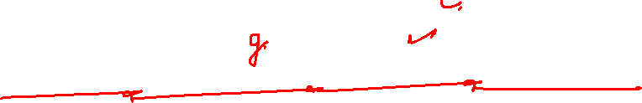

Slide 36
L-5: Project Management
Thank You!

